Slide 1

Exploring tourism trends
30 of the most visited places in the world

Slide 2




Slide 3

Exploring tourism trends - 30 of the most visited places in the world
Introduction to the Excel file:
Data used: from 2023 analysis of that year tourism trends
Variables:
- number of visitors
- average age of a tourist
- spends in a day of one person
- hotel room price for one night
- average number of days a tourist stays

Slide 4
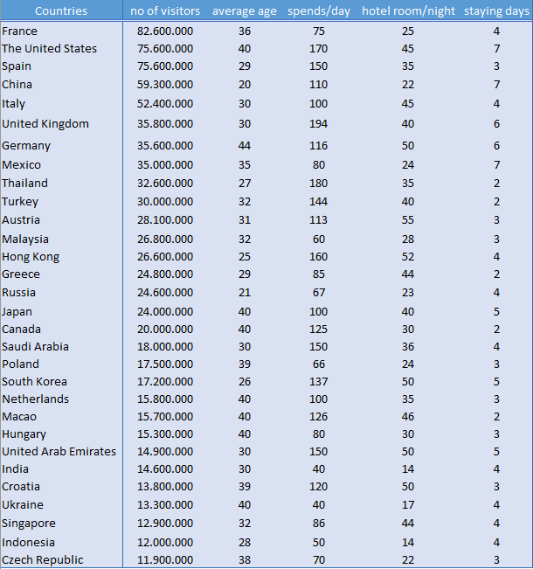
Exploring tourism trends - 30 of the most visited places in the world
Introduction to the Excel file:
Data used: from 2023 analysis of that year tourism trends
Variables:
- number of visitors
- average age of a tourist
- spends in a day of one person
- hotel room price for one night
- average number of days a tourist stays

Slide 5
Exploring tourism trends - 30 of the most visited places in the world
The values listed may seem to not have any relation, but let’s analize them.
Let’s group:
- no of visitors with I. average age
II. spends/day
III.hotel room/night
IV.staying days
- average age with 1. spends/day
2. hotel room/night
3. staying days
- spends/day with a. hotel room/ night
b. staying days
- hotel room and staying days

Slide 6
Exploring tourism trends - 30 of the most visited places in the world

Slide 7
Exploring tourism trends - 30 of the most visited places in the world

Slide 8
Exploring tourism trends - 30 of the most visited places in the world

Slide 9
Exploring tourism trends - 30 of the most visited places in the world

Slide 10
Exploring tourism trends - 30 of the most visited places in the world
There’s one group which have a positive relation, the other ones don’t have any.

Slide 11
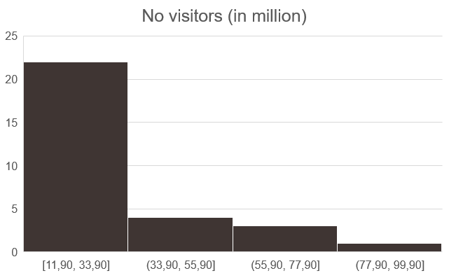
Exploring tourism trends - 30 of the most visited places in the world
We can group the statistical units into classes:

Slide 12
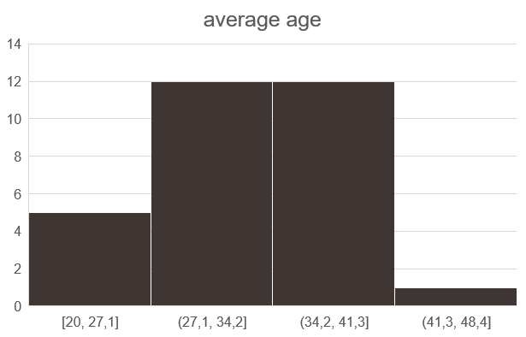
Exploring tourism trends - 30 of the most visited places in the world
We can group the statistical units into classes:
Young adults Adults Middle aged

Slide 13
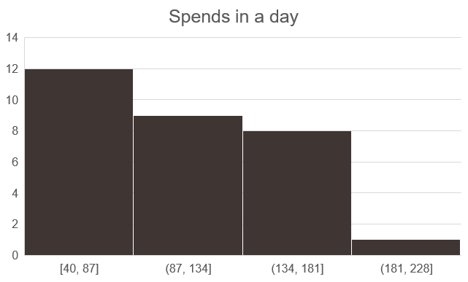
Exploring tourism trends - 30 of the most visited places in the world
We can group the statistical units into classes:
‘money’ saver indiferent compulsive

Slide 14
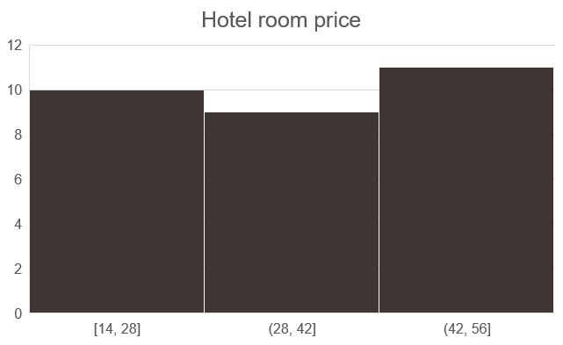
Exploring tourism trends - 30 of the most visited places in the world
We can group the statistical units into classes:
low cost moderated cost high cost

Slide 15
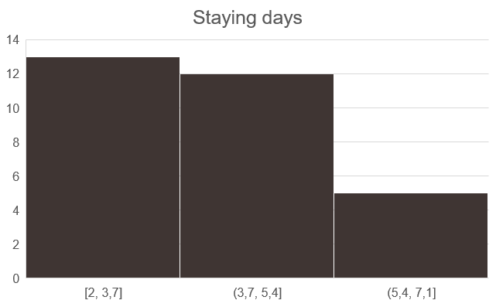
Exploring tourism trends - 30 of the most visited places in the world
We can group the statistical units into classes:
(person)in a hurry moderated takes his time

Slide 16
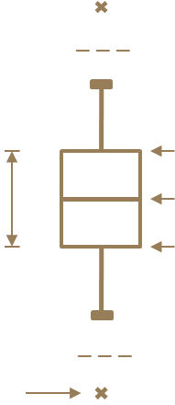
Exploring tourism trends - 30 of the most visited places in the world
Box plot
max=44
max=194
max=55
max=7
max=82,6 M
_ _ _
_ _ _
_ _ _
_ _ _
Q1=15,2 M
Q1=29
Q1=73,75
Q1=24
Q1=3
IQR
19.950k
IQR
11
Q2=32
IQR
71,75
Q2=105
IQR
21,25
IQR
2
Q2=24,3 M
Q2=35,5
Q2=4
Q3=35,15 M
Q3=40
Q3=145,5
Q3=45,25
Q3=5
_ _ _
_ _ _
_ _ _
_ _ _
outlier
min=11.9 M
min=20
min=40
min=14
min=2

Slide 17
Project made by Smeu Estera-Valentina, I year, group 1040
Bucharest University of Economic Studies - ASE
Source
https://govisity.com/most-visited-countries-world/
course materials by Prof. dr. Monica Roman, ASE

